Slide 1
Sungir and Mladec respiratory adaptation to climate
Katya Stansfield, Lauren Butaric

Slide 2
CT scans of two fossils, Sungir and Mladec and 15 human groups from around the world
The morphology in question includes external, internal nose and sinuses;
The questions:
What are the features of climate adaptation in these fossils?
What type of the climate do these fosslis display adaptation to?
What is the likelihood of their adaptation to one or another climate environment?

Slide 3
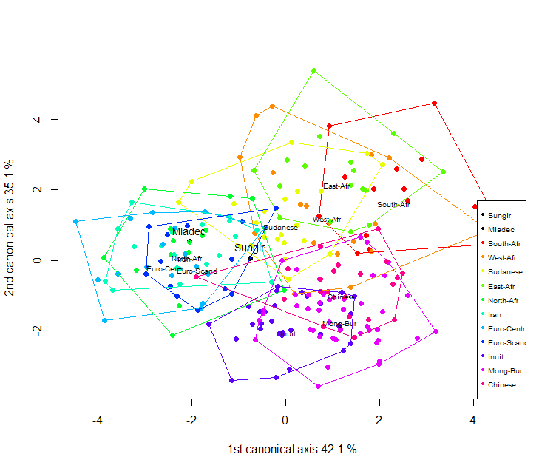
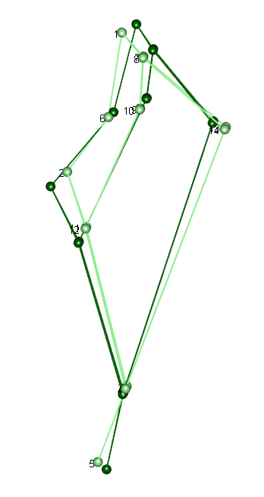
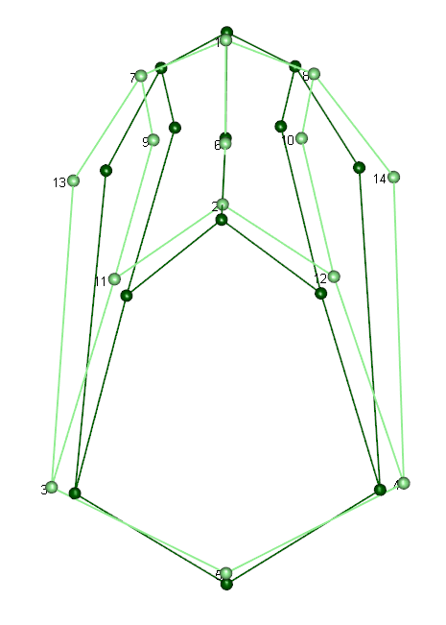
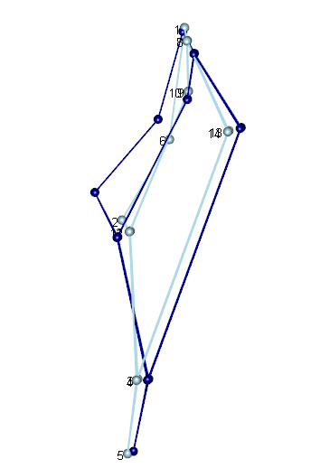
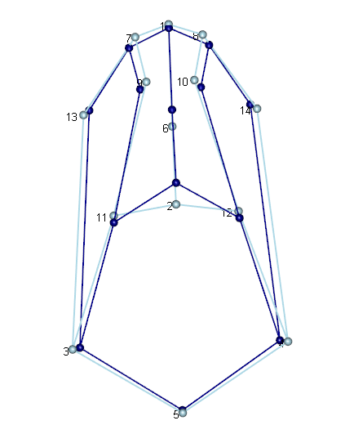
CV analysis of the external nose
GEOMORPH: CVA was calculated on modern groups, fossils are projected into CV space.
QUESTION: How can I calculate posterior probabilities for Sungir and Mladec to belong to any of the groups?
Dark frame – positive
Light frame - negative

Slide 4
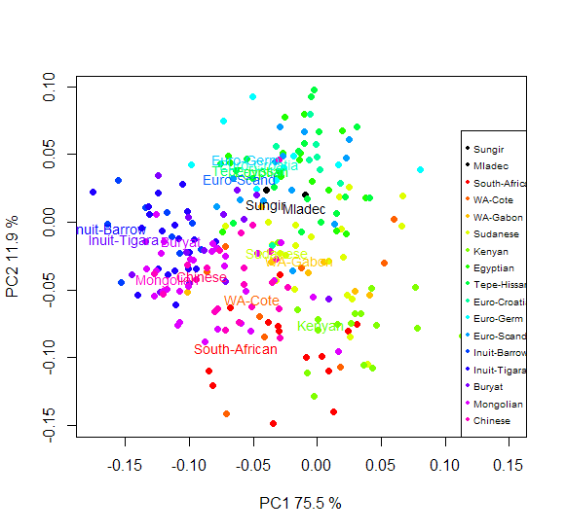
GLS for group means (lm.rrpp), 4 independent climate variables, Cov = matrix based on geographical distances.
PCs calculated on predicted shapes, data projected into the resultant space
Full Model Analysis of Variance
Df Residual Df SS Residual SS Rsq F Z (from F) Pr(>F)
fit2 4 10 0.1253079 0.2219681 0.3608309 1.411328 0.7475181 0.3333333
Analysis of Variance, using Residual Randomization
Permutation procedure: Randomization of null model residuals
Number of permutations: 1
Estimation method: Generalized Least-Squares (via OLS projection)
Sums of Squares and Cross-products: Type I
Effect sizes (Z) based on F distributions
Df SS MS sq F Z Pr(>F)
TMN 1 0.06734 0.067338 0.19390 3.0337 0.79750 0.3333
TMX 1 0.01506 0.015059 0.04336 0.6784 0.03061 0.6667
HMN 1 0.02814 0.028140 0.08103 1.2677 0.93262 0.3333
HMX 1 0.01477 0.014771 0.04253 0.6654 -0.19279 0.6667
Residuals 10 0.22197 0.022197 0.63917
Total 14 0.34728
Call: lm.rrpp(f1 = coords ~ TMN + TMX + HMN + HMX, iter = 0, SS.type = "I",
data = df, Cov = weights, print.progress = FALSE)
QUESTION: Is it a valid path to find morphology predicted by climate minus geographical proximity effect?

Slide 5
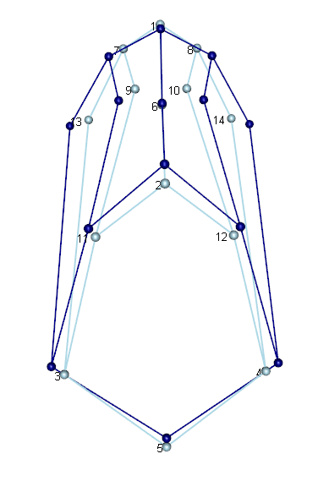
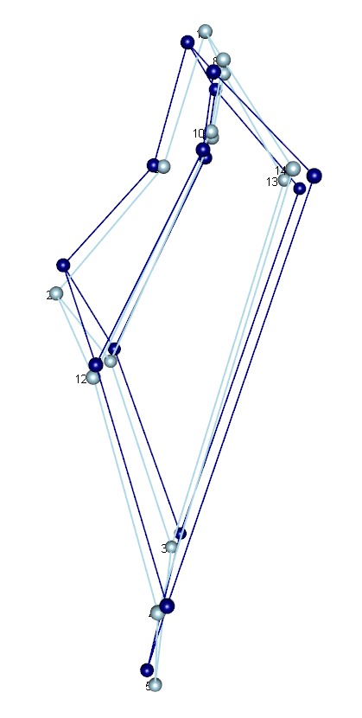
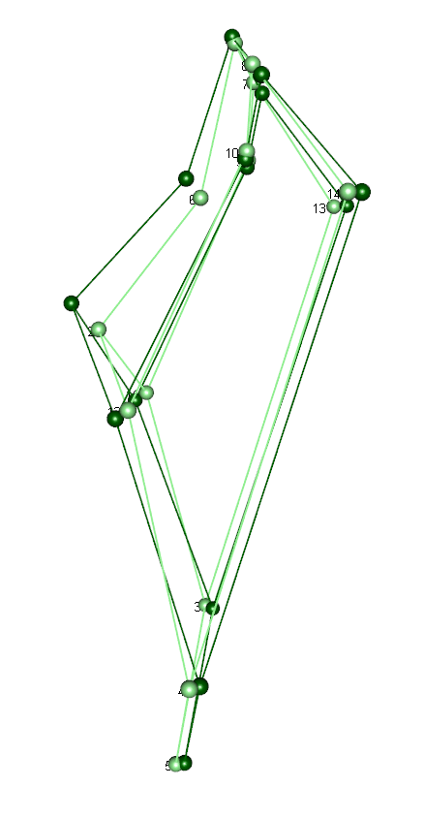
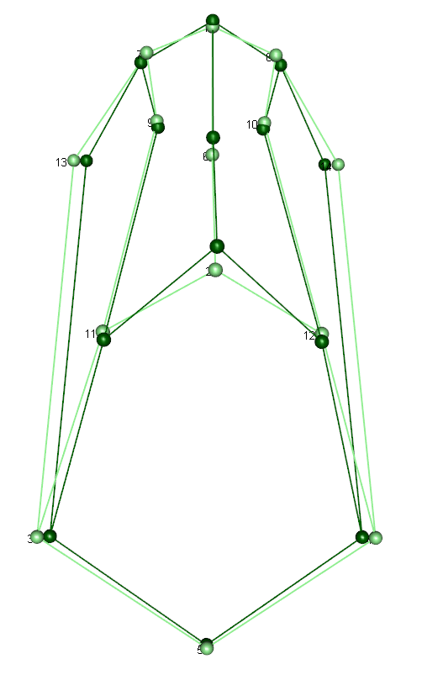
Shape changes along the GLS-prescribed principal components
PC2
PC1
Light – negative,
Dark - positive

Slide 6
Questions
CVA: How can I calculate posterior probabilities for Sungir and Mladec to belong to any of the groups?
GLS: Is it a valid path to find morphology predicted by climate minus geographical proximity effect?
General: How can I estimate the likelihood of the fossils‘ adaptation to one or another climate environment given the morphology?

